Slide 1

Canada wide vegetation essential climate variables: fCOVER, fAPAR and LAI
Richard Fernandes richard.fernandes@nrcan-rncan.gc.ca
Francis Canisius, Najib Djamai, Gang Hong, Cassidy Li, Hichem Lahiouel, Camryn MacDougall, Hemit Shah, Lixin Sun

Slide 2
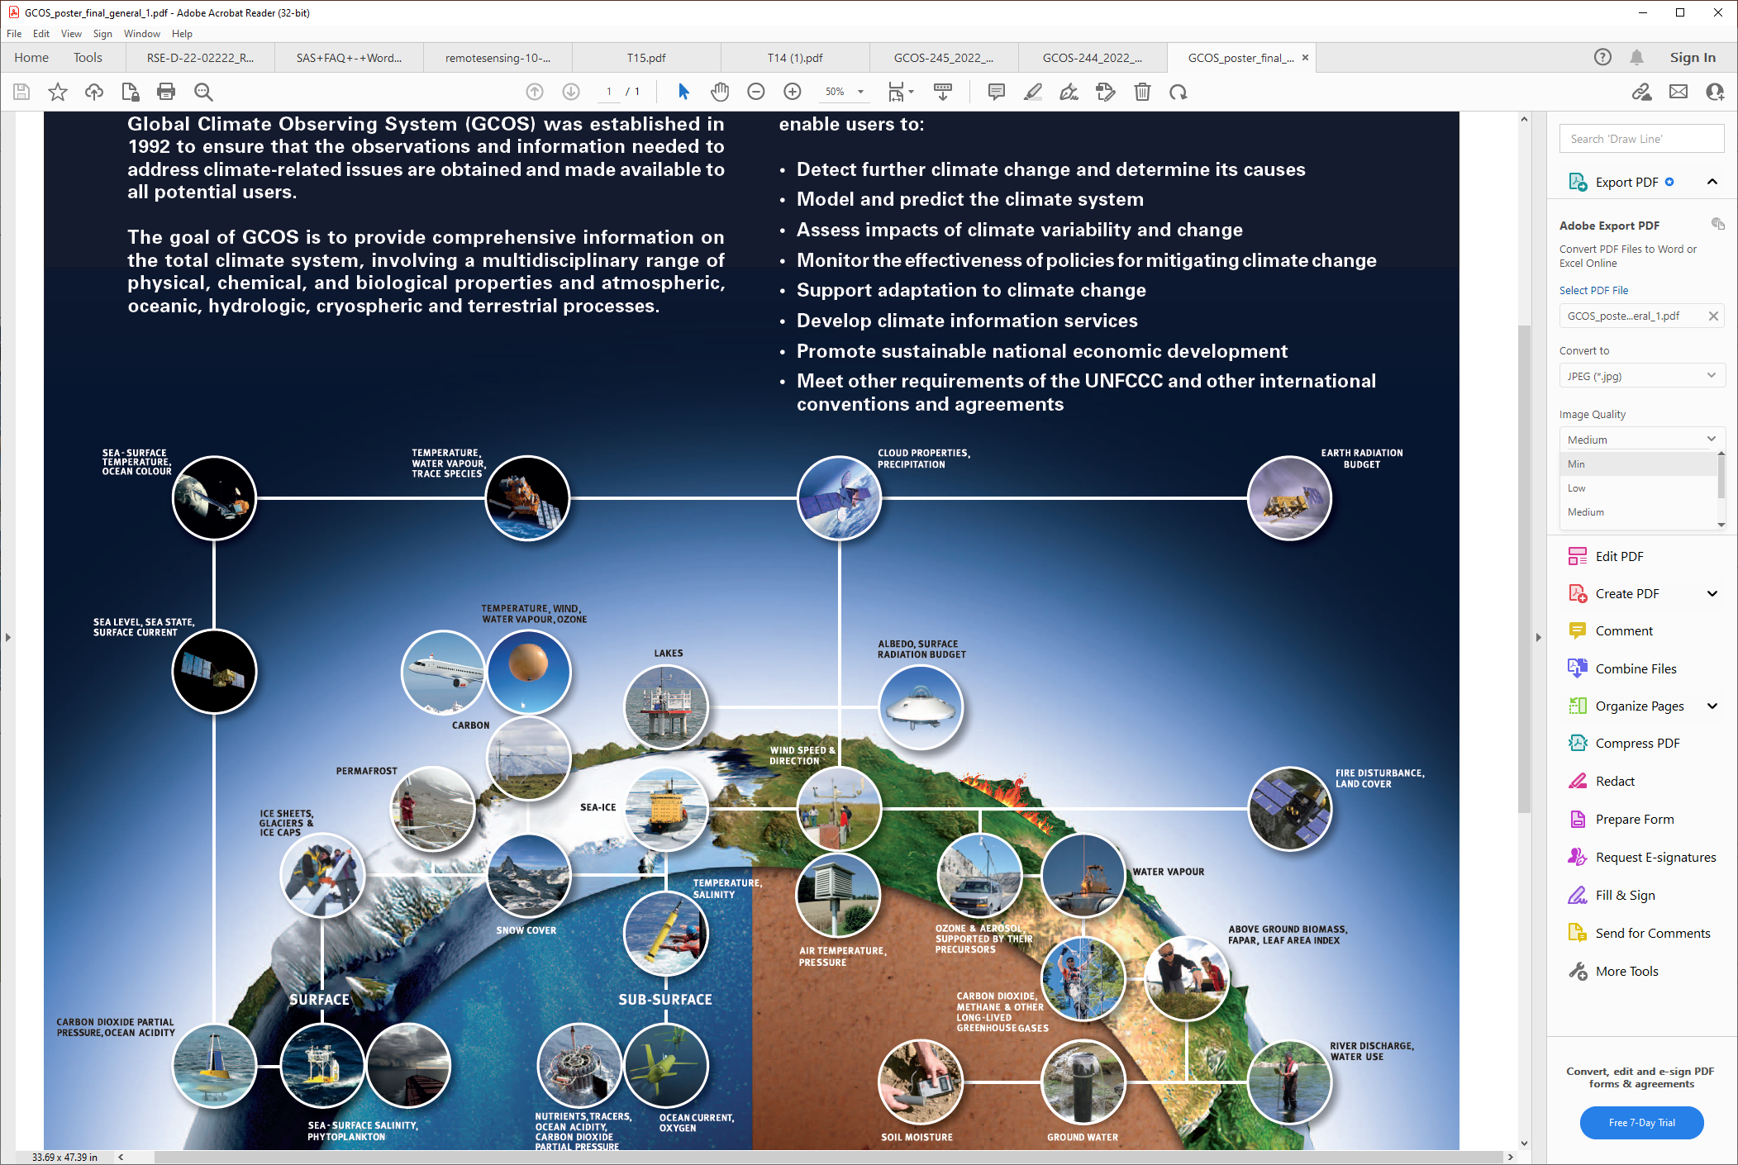
Vegetation Essential Climate Variables
Canopy Cover (fCOVER)
Foliage presence
Habitat
Land cover change
fAPAR
Foliage productivity/health
Status and trends
Crop modelling
Leaf Area Index
Foliage density/biomass
Status and trends
Ecosystem/weather models
https://gcos.wmo.int/en/essential-climate-variables

Slide 3
GCOS User Requirements
Variable | Definition | Horizontal Resolution m |  |  | Temporal Resolution days |  |  | Uncertainty (%,abs), 2σ |  |  | Stability %/10y
 |  | G | B | T | G | B | T | G | B | T | G | B | T
fCOVER | the fraction of ground covered by green vegetation | 10 | 30 | 333 | 7 | 30 | 99 | - | - | 10%, 0.05
fAPAR | part of PAR that is effectively absorbed by plants | 10 | - | 250 | 1 | - | 10 | 5%, 0.025 | - | 10%, 0.05 | 1.5 |  | 3
LAI | Half total green foliage area per horizontal ground area | 10 | 100 | 250 | 1 | - | 10 | 10%, 0.5 | 15%, 0.5 | 20%,0.5 | 3 |  | 6
https://library.wmo.int/index.php?lvl=notice_display&id=22135

Slide 4
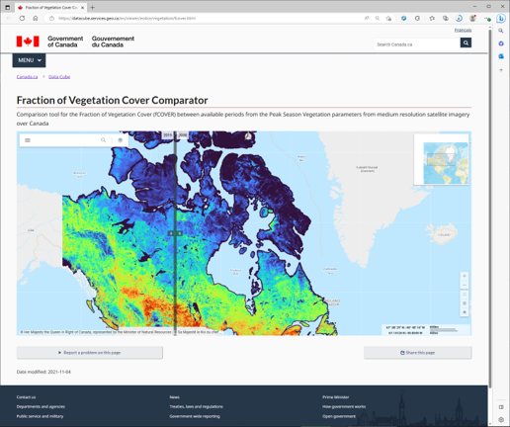
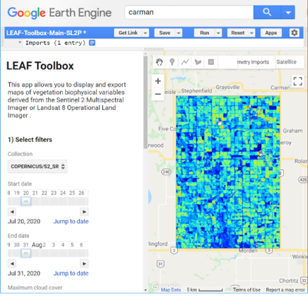
20m, monthly May-Sept 20m cloud free
http://github.com/rfernand387/LEAF-Toolbox

Slide 5
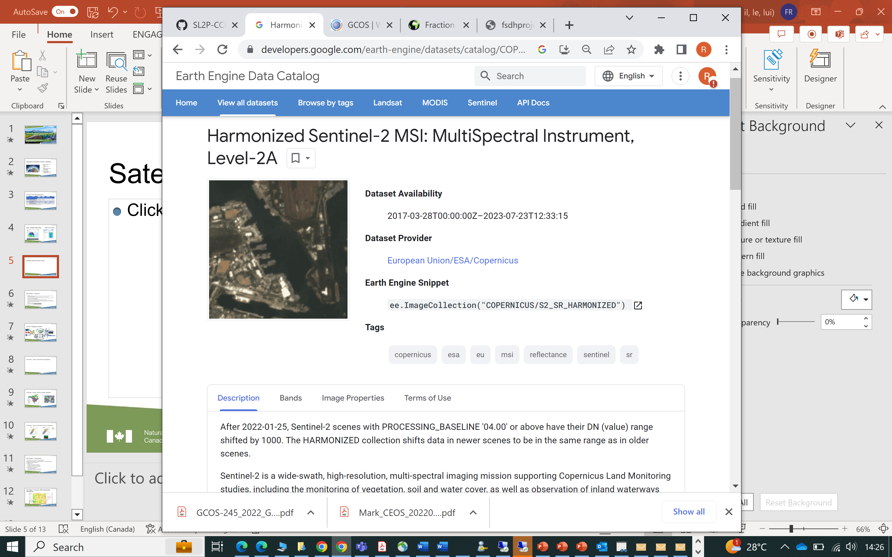
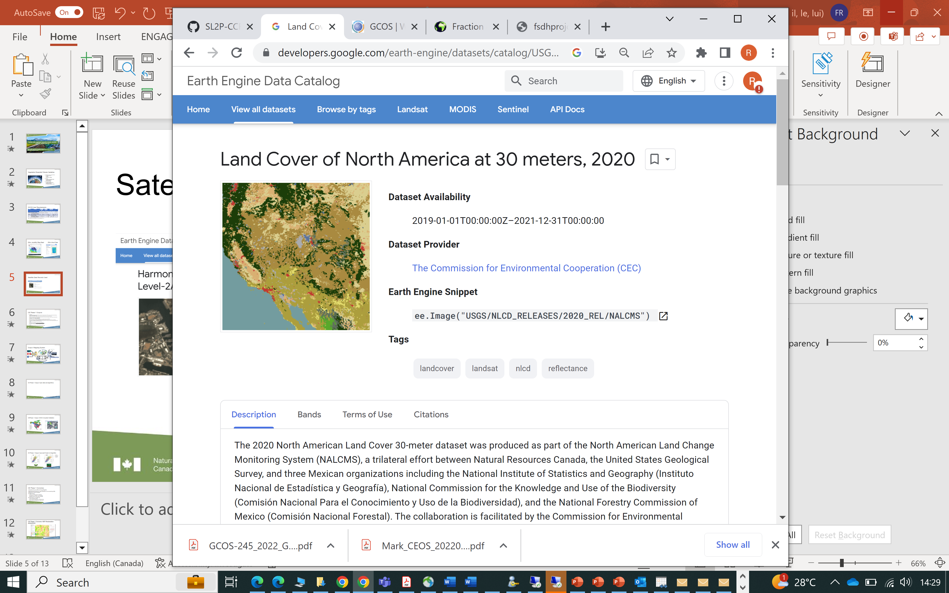
Input Satellite Data Records
Prior to 2019 to be available in 2024
Annual products to be employed in 2024.

Slide 6
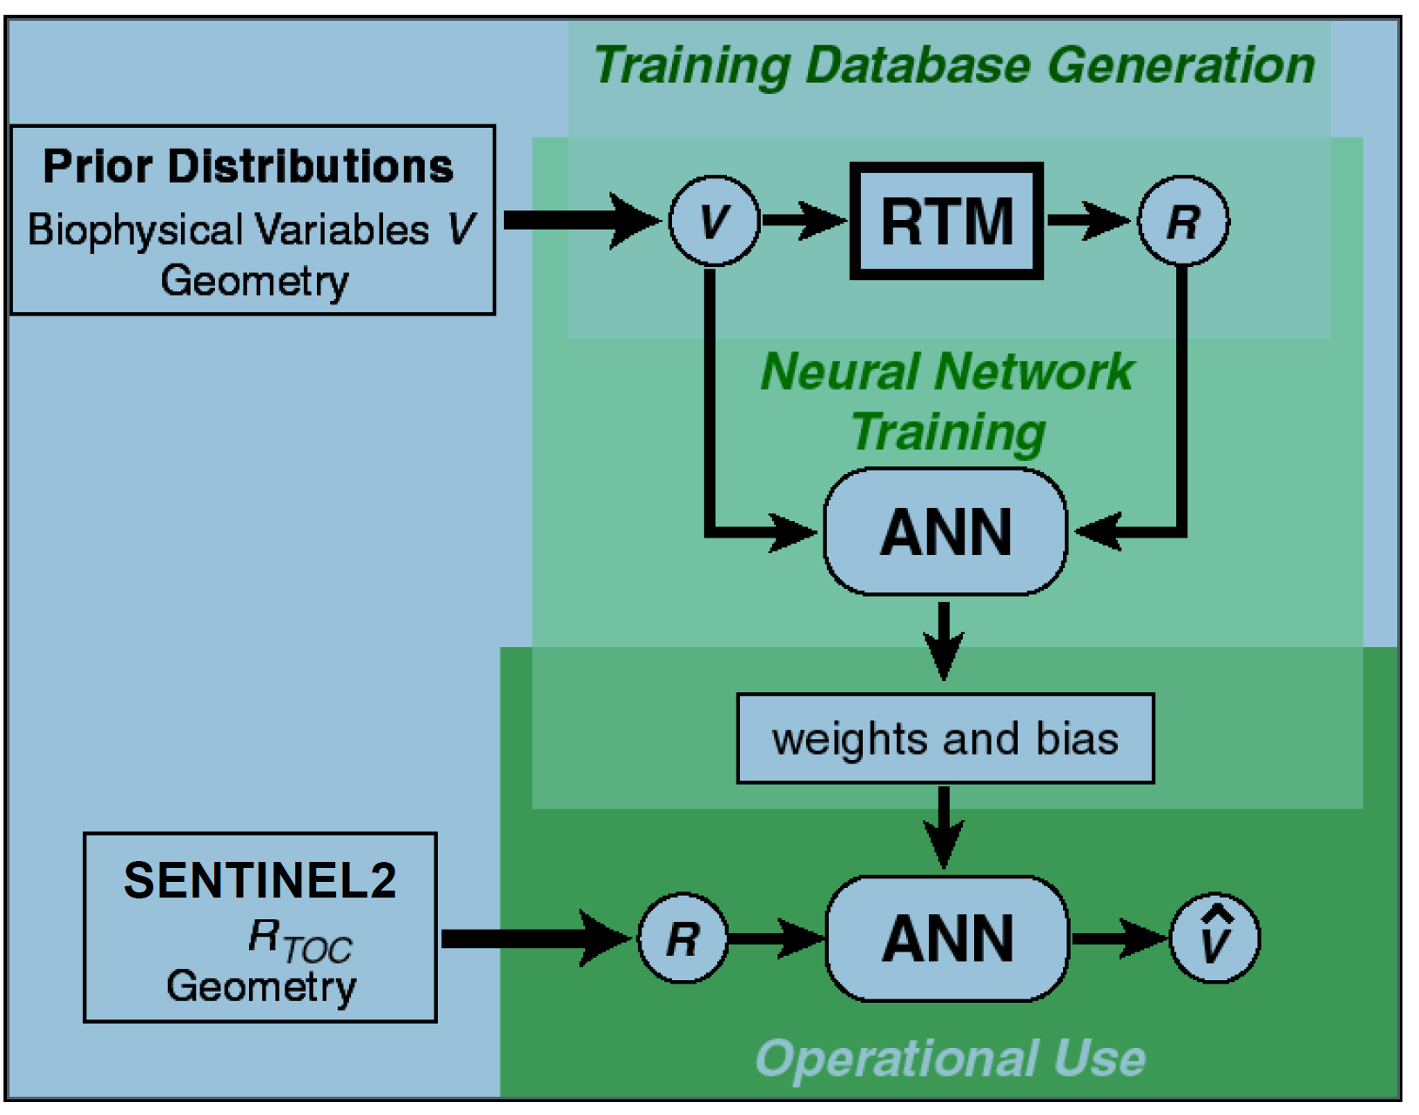
Algorithm – SL2P-CCRS
https://github.com/rfernand387/SL2P-CCRS/blob/main/Documents/SL2P-CCRS-ATBD.docx

Slide 7
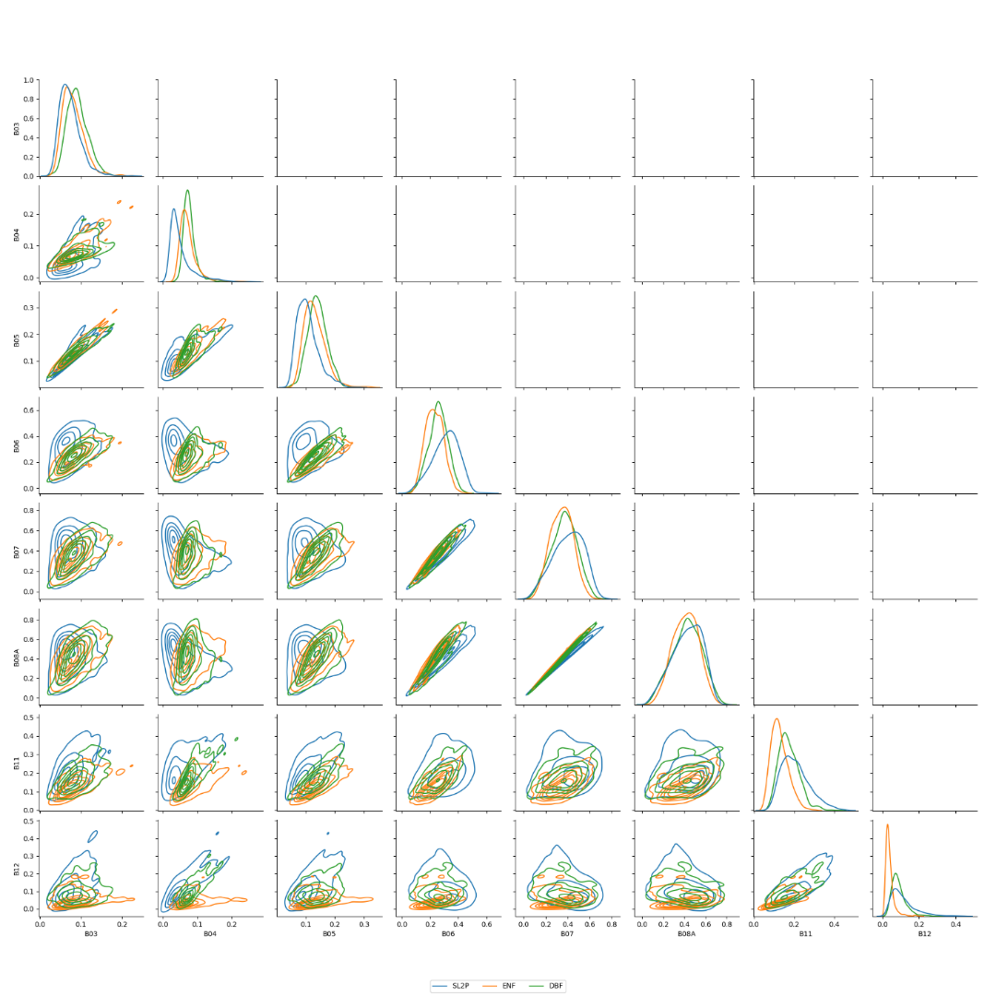
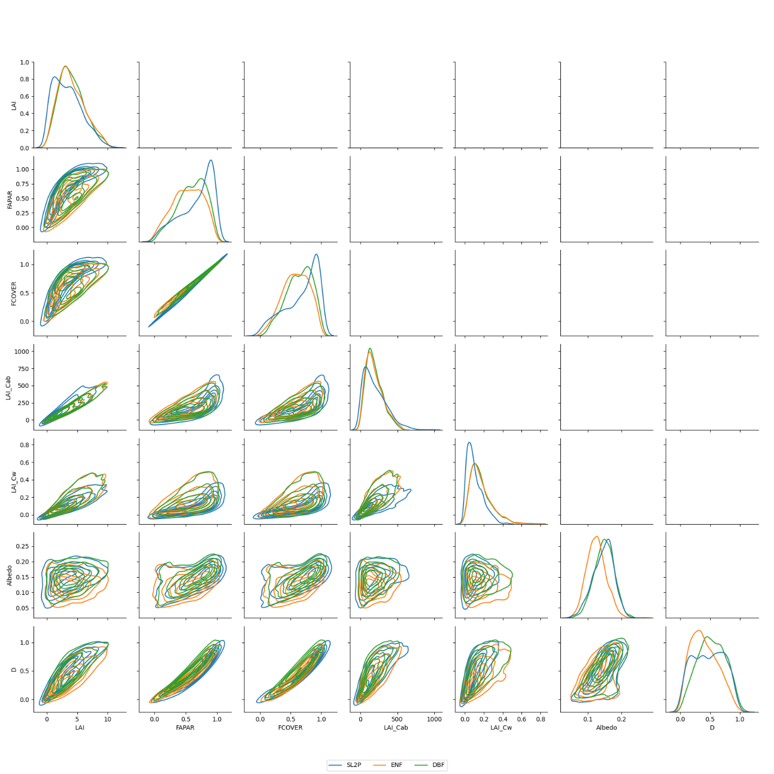
Algorithm – Quality Indices
Out of Domain
Out of Range
pdf(LAI)

Slide 8

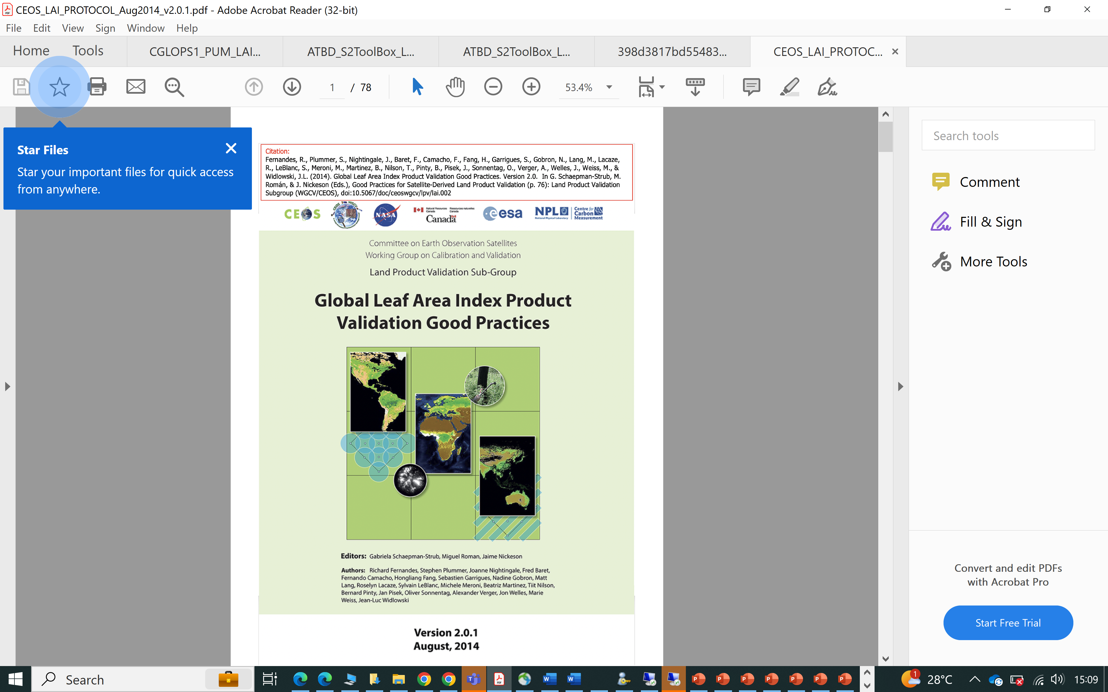
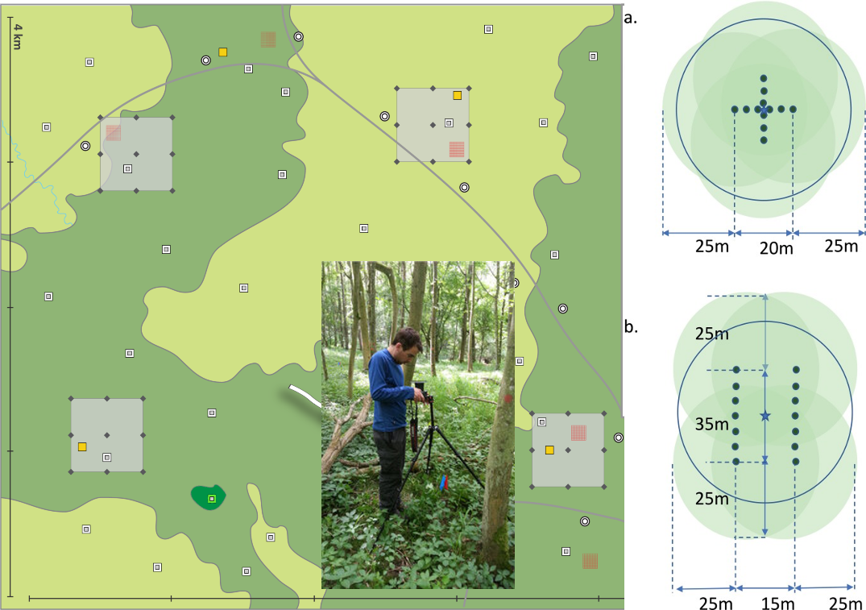
Validation Methodology
Uncertainty (U) : RMSE
Accuracy (A): average difference
Precision (P): RMSE after subtracting A
Uncertainty Agreement Ratio (UAR): fraction retrievals meeting user requirement

Slide 9
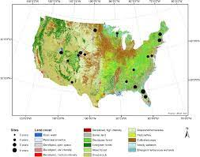
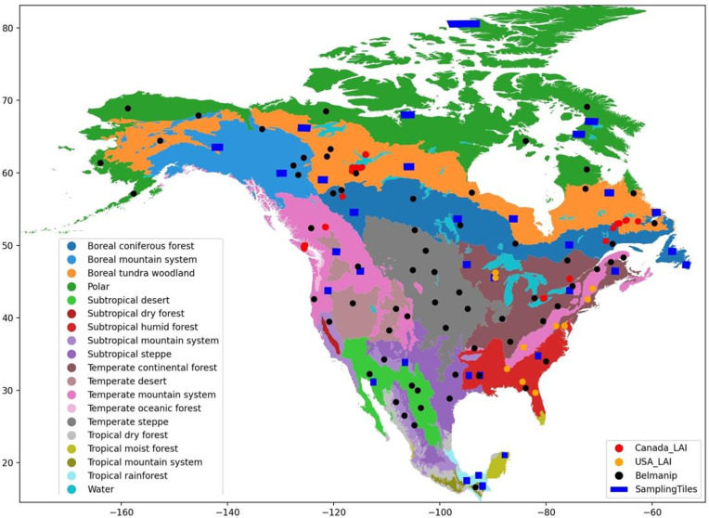
Validation Sites (232 sites, 1385 samples)

Slide 10
SL2P-CCRS Validation Summary (n=1385)

Slide 11
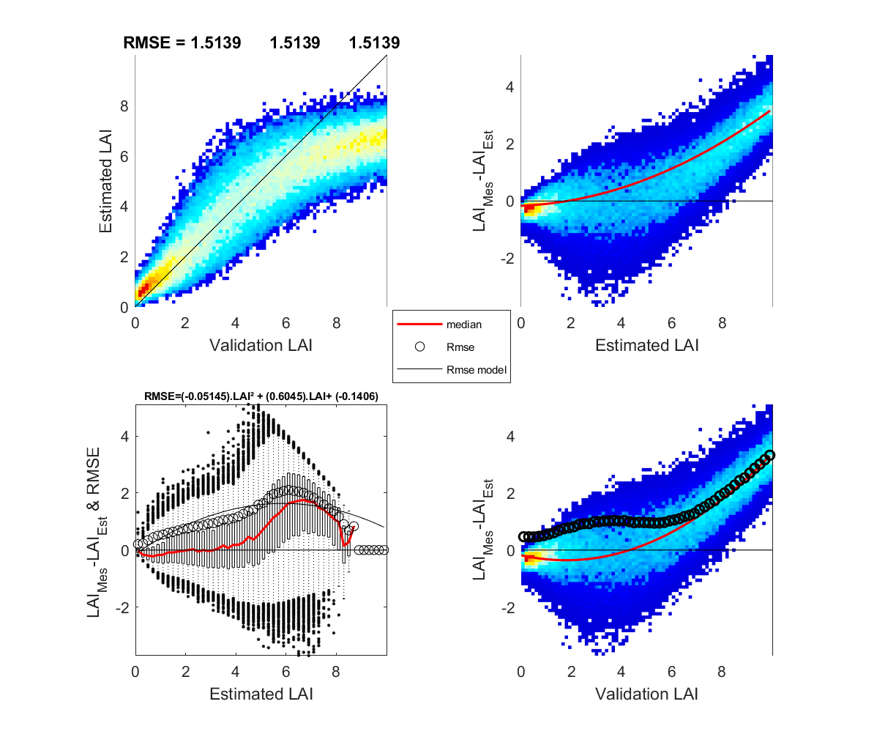
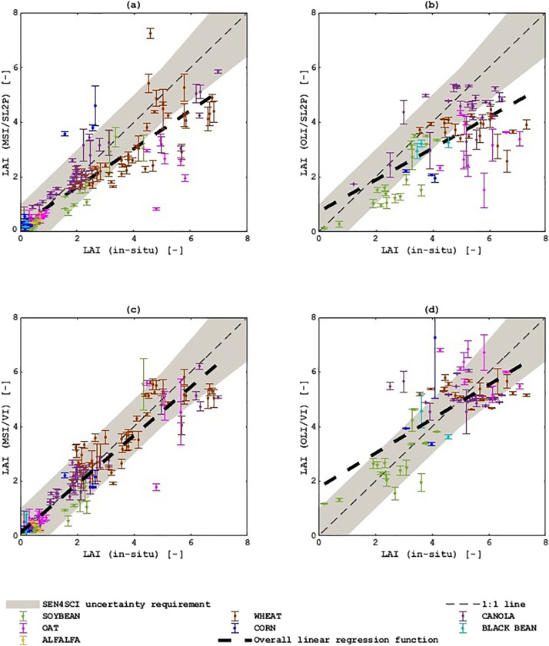
Non-woody vegetation: LAI
N=176
R2=
A=-0.37
U=0.98
UAR=0.8

Slide 12
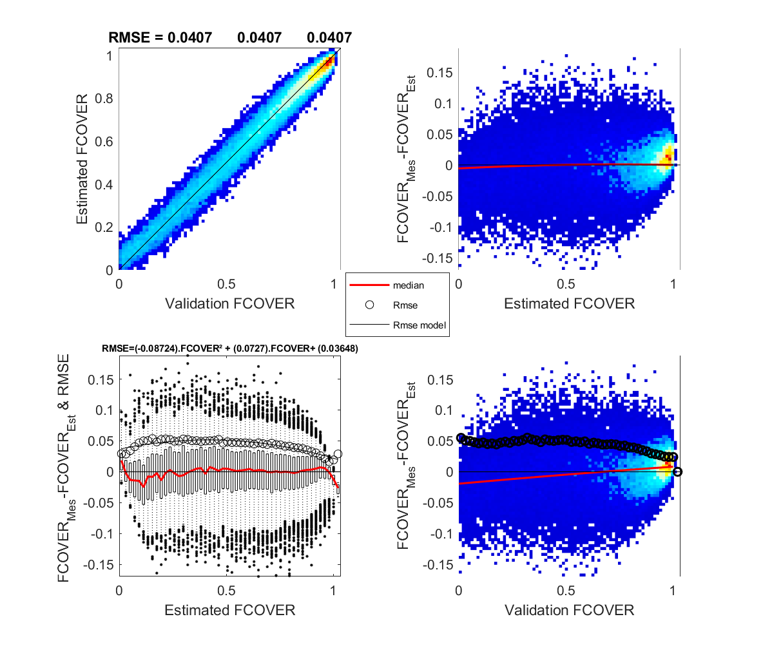
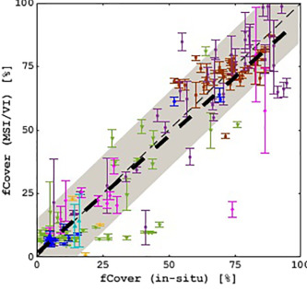
Non-woody vegetation: fCOVER
N=177
R2=
A=-0.018
U=0.1139
UAR=0.84

Slide 13
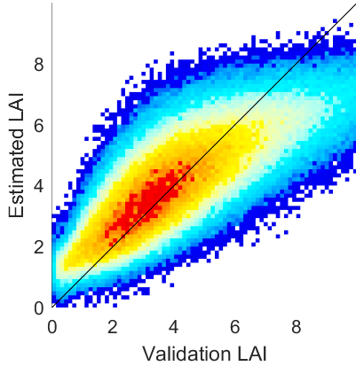
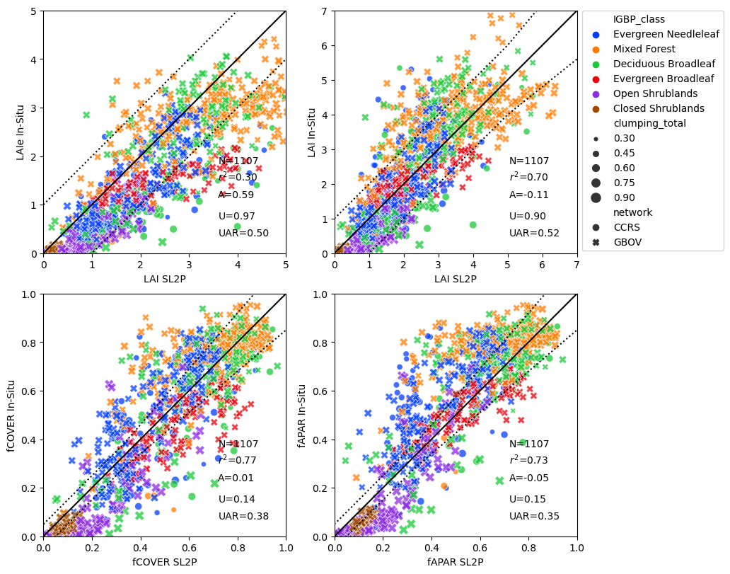
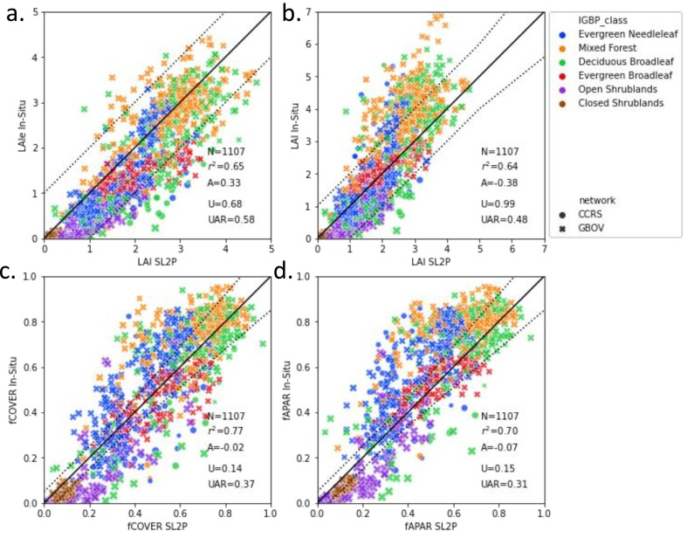
Woody vegetation: LAI

Slide 14
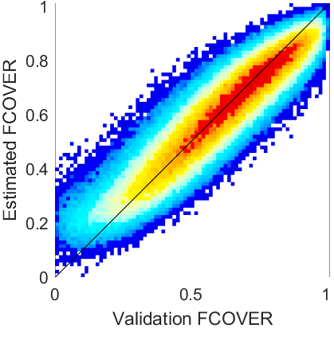
Woody vegetation: fCOVER

Slide 15
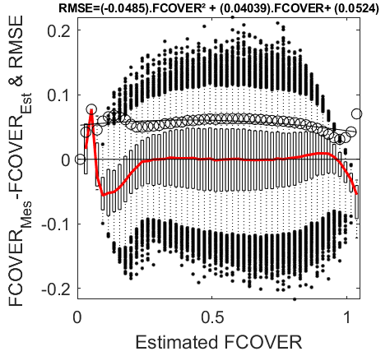
Uncertainty Models – FCOVER
Non-Woody Woody

Slide 16
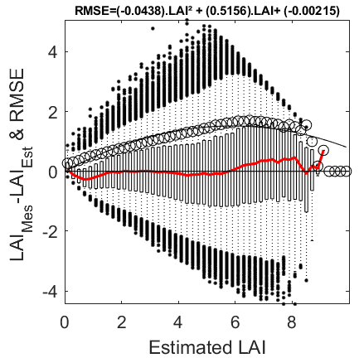
Uncertainty Models – LAI
Non-Woody Woody

Slide 17
User Caveats
Snow free, vegetated
Within domain and range
20m pixel U:
Lower: cross-validation RMSE
Upper: in-situ validation RMSE
Aggregated pixels
RMSE models to be confirmed
Issues
Partial snow
Flooding
Terrain shadow
Terrain slope
Haze and clouds
Mixed cover classes
Land cover error

Slide 18
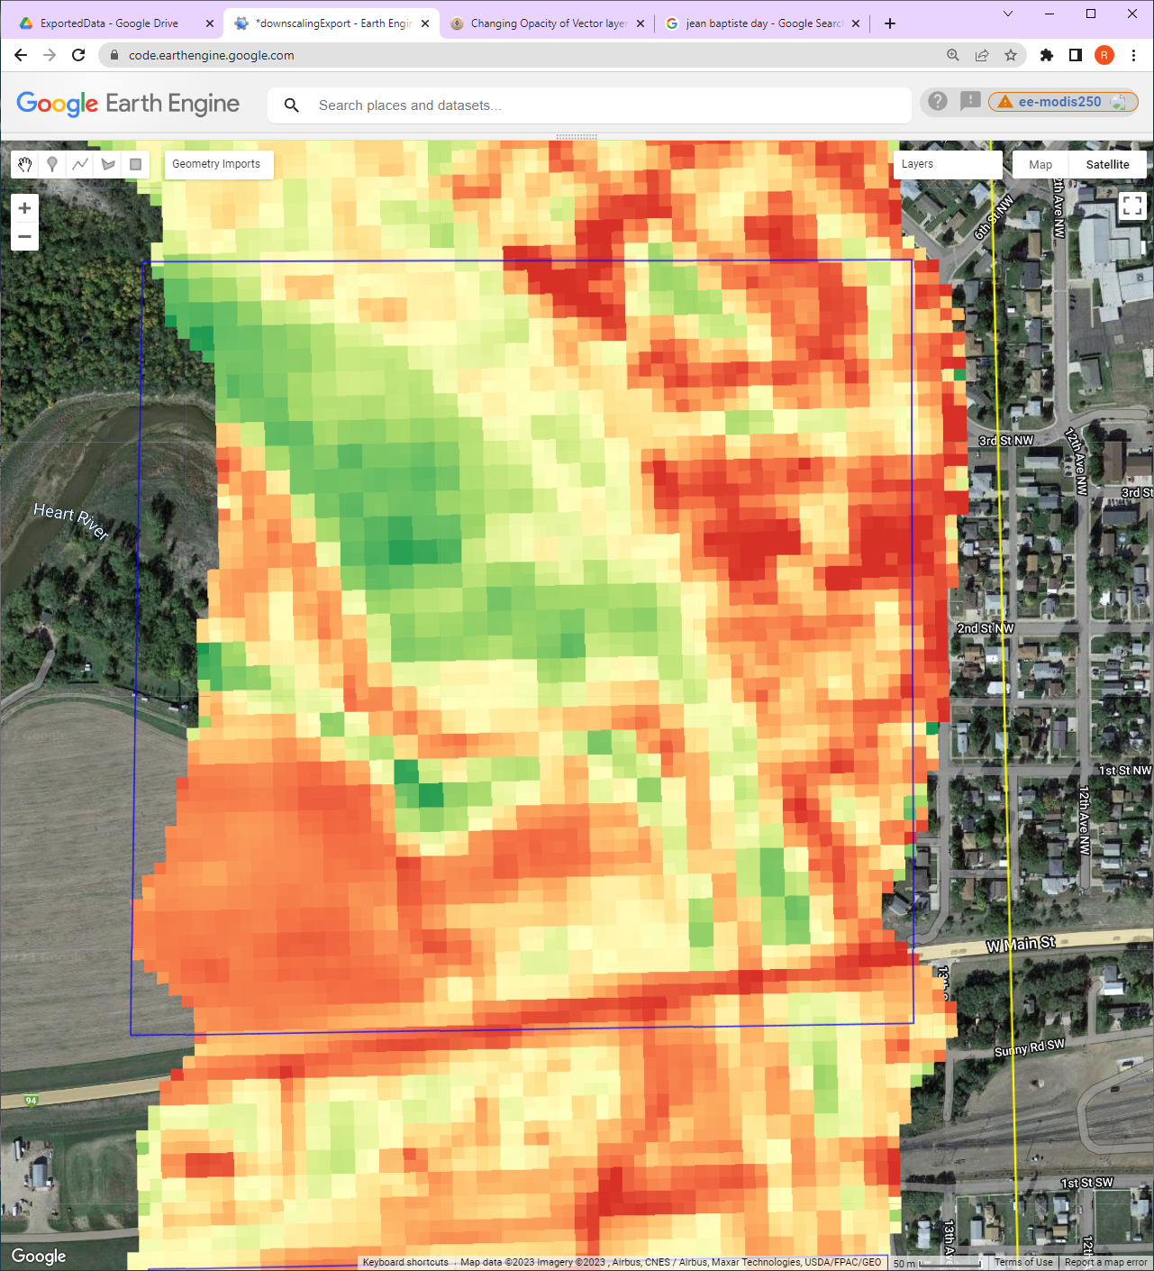
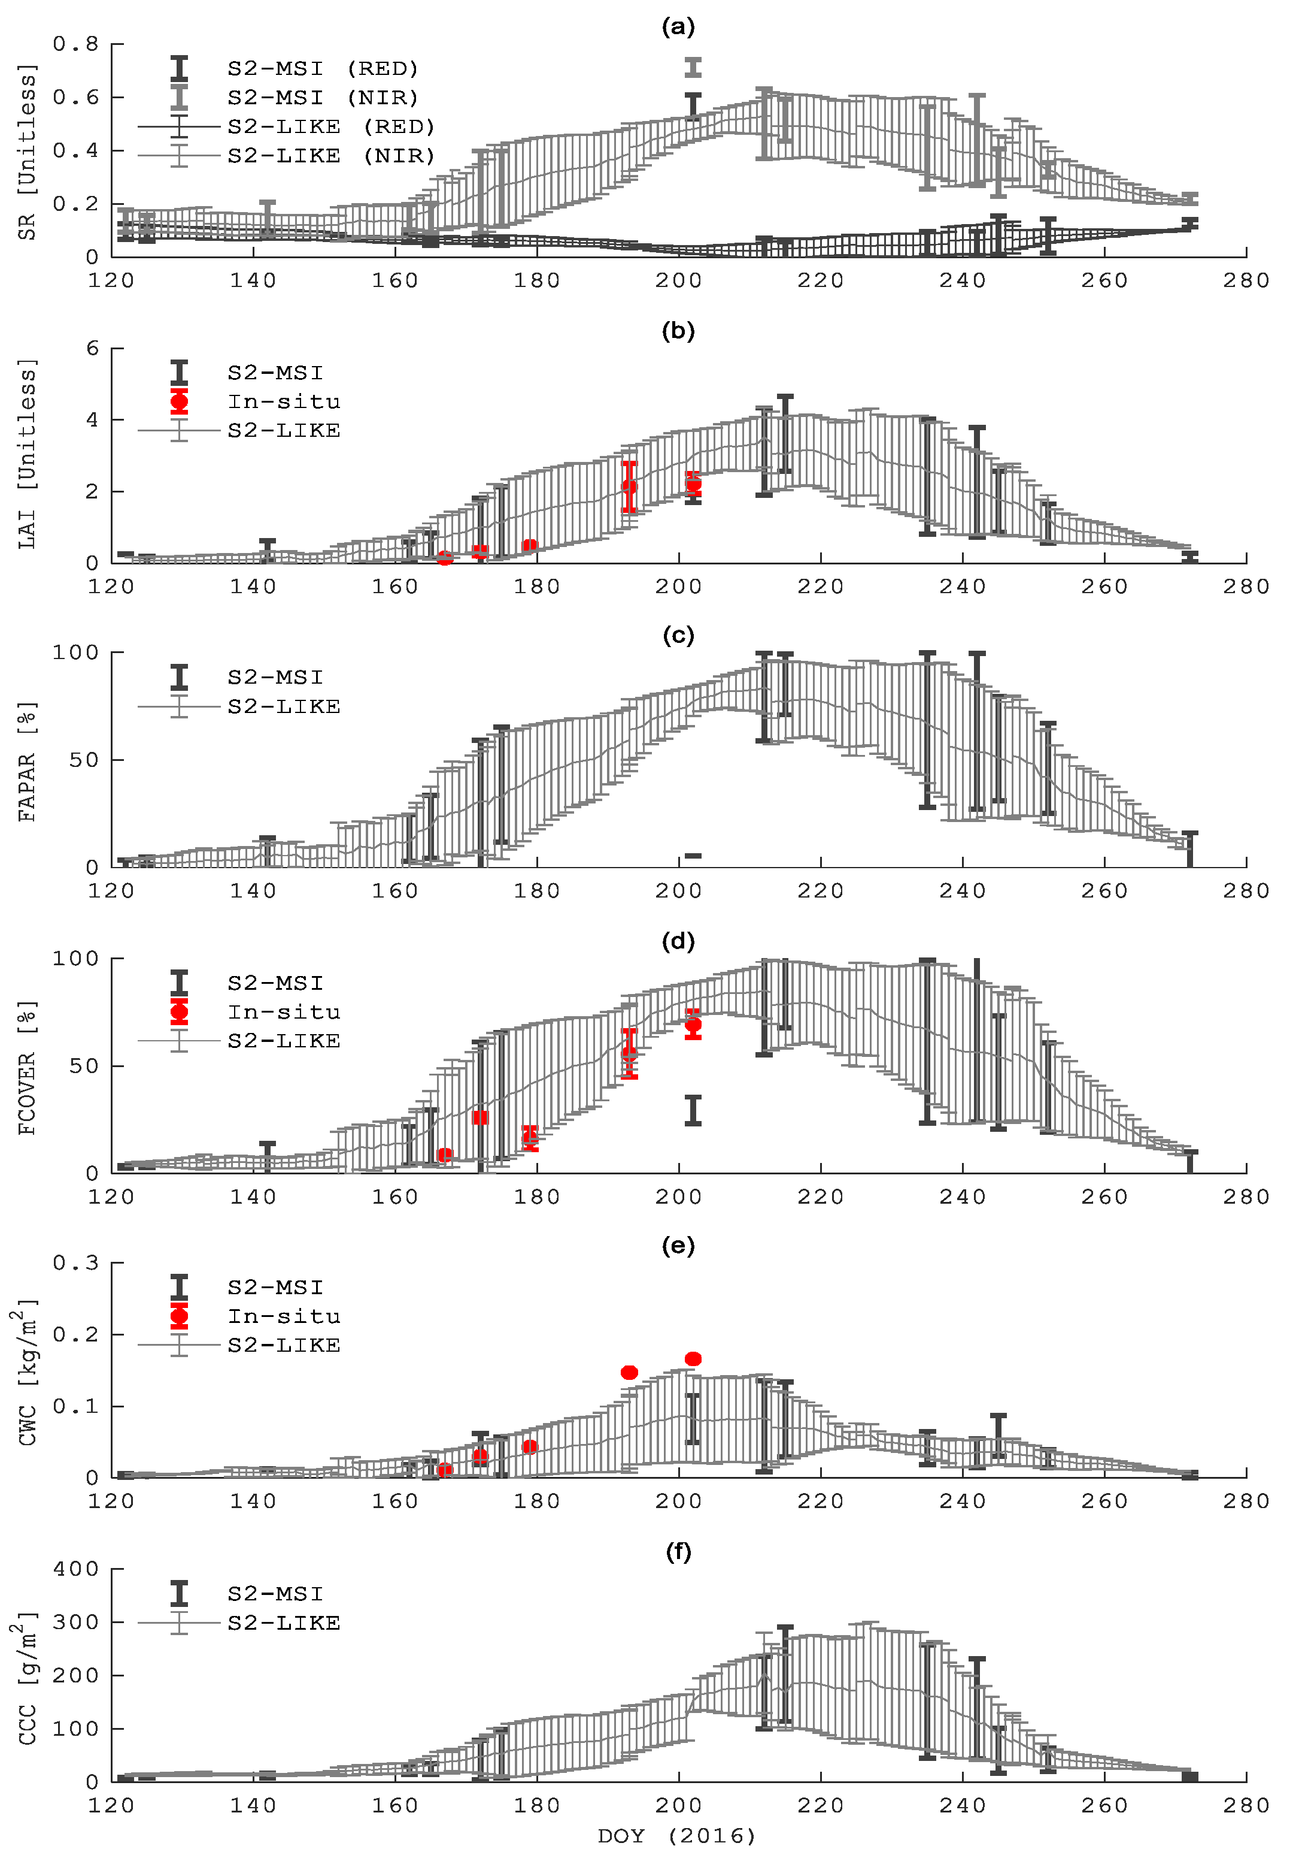
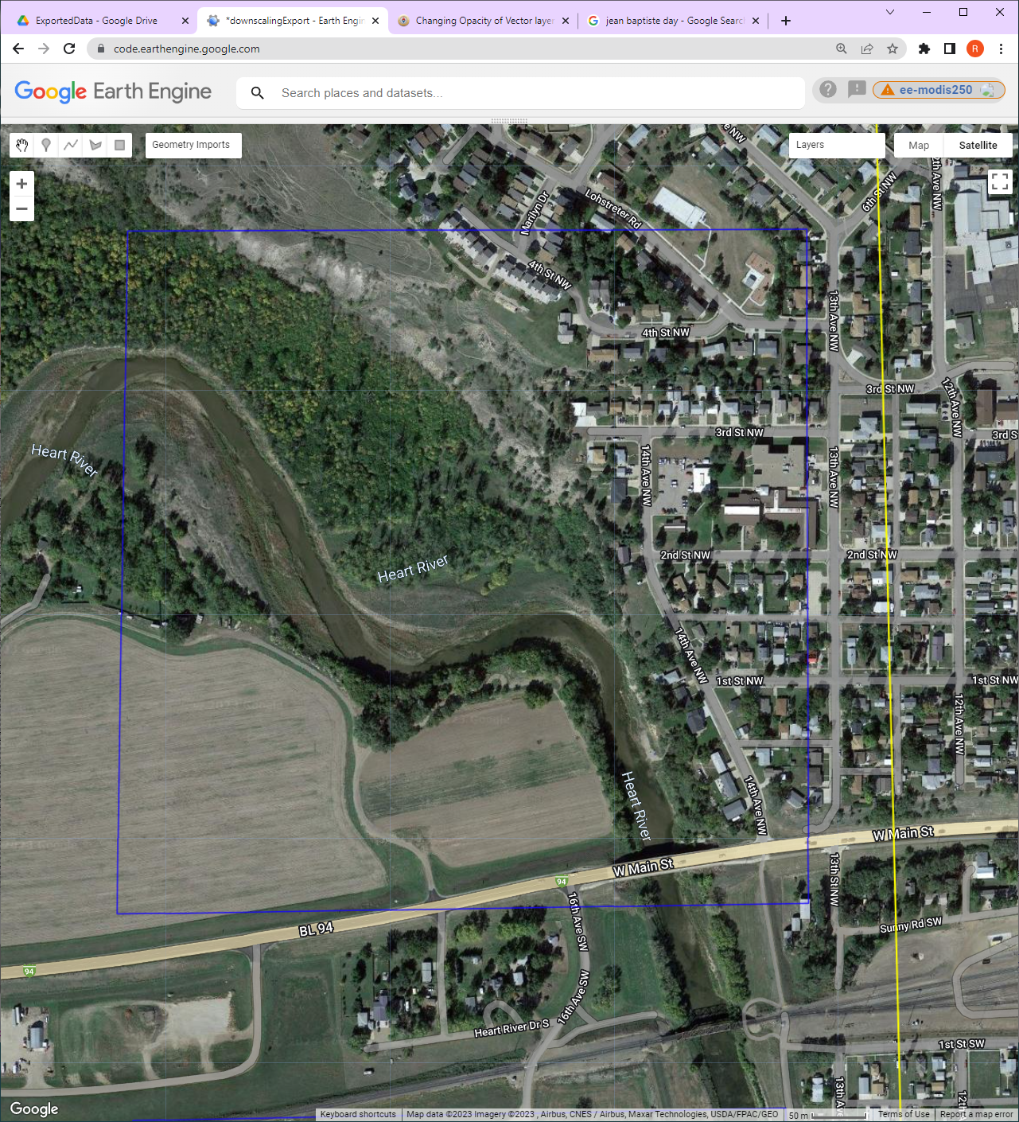
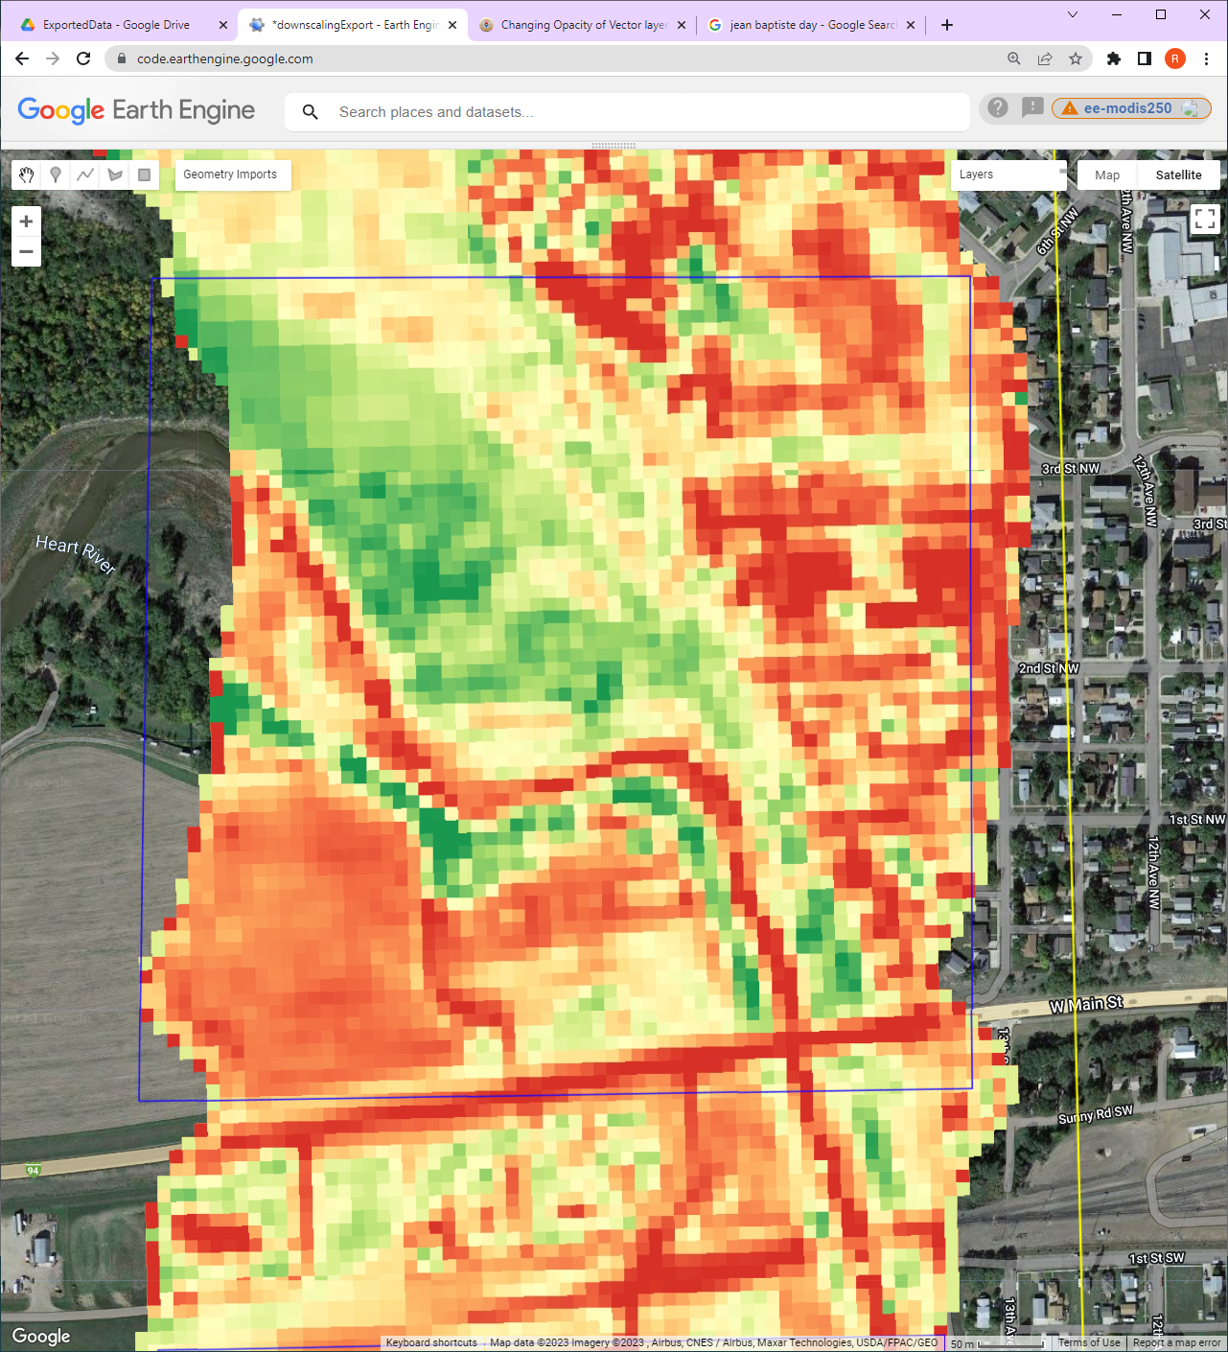
Potential Enhancements
Daily Estimation (S2+MODIS)
Downscaling to 10m (S2)
LAI
20m
LAI
10m

Slide 19
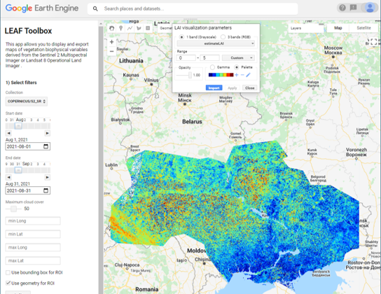
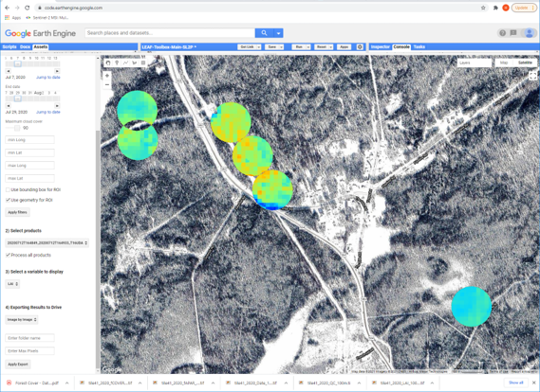
LEAF-Toolbox

Slide 20
References
GITHUB
rfernand387/LEAF-Toolbox
rfernand387/sl2p-ccrs
fqqlsun/LEAF_production
hongirsa/PSRFM_Wrapper
Data
https://datacube.services.geo.ca/en/viewer/eo4ce/vegetation/monthly-vegetation.html
https://open.canada.ca/data/en/dataset/37745ea7-d0cf-4ef6-b6b8-1cb3a7fce0b8
ATBDs
https://github.com/rfernand387/SL2P-CCRS/blob/main/Documents/SL2P-CCRS-ATBD.docx
http://step.esa.int/docs/extra/ATBD_S2ToolBox_V2.0.pdf

Slide 21
UAR Increases with Averaging

